Slide 1


IBM Cloud Workshop
Hochschule Reutlingen
Matthias Kubik,
Steffen Uhlig,
Martin Henke &
Sugandha Agrawal

Slide 2
















The rate of innovation is increasing
“Two guys in a Starbucks can have access to the same computing power as a Fortune 500 company.”
Jim Deters - Founder, Galvanize
Design Thinking
Runtimes
APIs
Micro
services
IoT
Extreme
Agile
Tooling
Containers
Notes:
The digital disruption is underway across all industries, and at the core of this disruption is a transformation and acceleration of innovation, development and delivery methods. Enterprise executives recognize the significance of this transformation and are seeking ways to bring the culture of startup innovation into their enterprise. They need to lead the digital disruption or risk being disrupted -- digitally disintermediated from their customers, employees, or suppliers. Born on the cloud startups are leading many disruptions and using new methods to achieve these disruptive innovations.
These digital disruptors are delivering new business models and customer value at high speed and high quality, continuously iterating and experimenting in-field to achieve their desired business outcomes. Pivoting and rapidly iterating to achieve customer adoption and revenue growth.
These new methods, typically discussed as DevOps, encompasses a transformation of culture, processes and tools. In a manor that accelerates innovation, rapid instantiation of new services, and data driven iterations
2

Slide 3
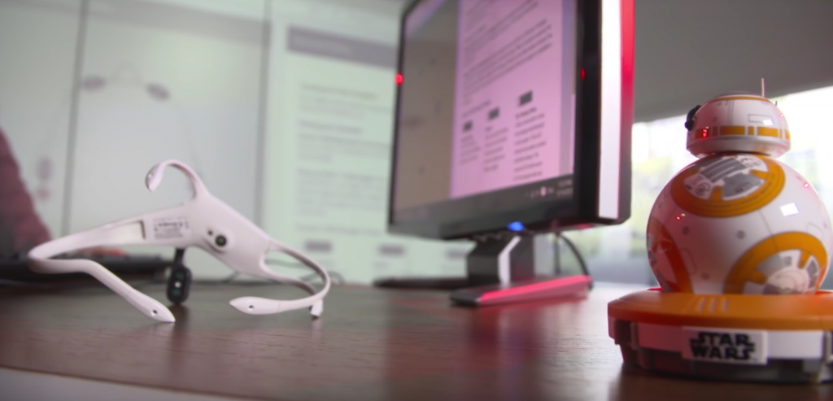
For the Star War Fans!!!

Slide 4

Monolith to Microservices - Example
Monolith
Microservice Based
Application
Orders service
DB
Storefront UI
Run-time
Orders
service
Storefront UI
Shipping service
DB
Proxy
DB
Shipping service
Run-time
Run-time
Catalog
service
Catalog service
DB
Run-time
Middleware
Notes:
The monolith is not always is a real monolith. For example, JEE distinguishes "web tier", "application tier" and "data tier“, with the first two tiers sharing a process (the application server), or not (say hello to SOA … but without cloud infrastructure SOA deployments might be complex)
Monolith Pros
Business as usual, it’s what we know
Simple to develop, build, test
Cons
Can be difficult to learn (by new comers), adapt and change
Deployment might be held back by slowest link
Hard to mix technology
Scaled as a whole
Microservice are not free either
Distributed system fallacies
Might be more difficult to comprehend (more moving parts, implicit dependencies) and debug (asynchronous flows across multiple processes)
Consistency model is harder to reason about
4

Slide 5
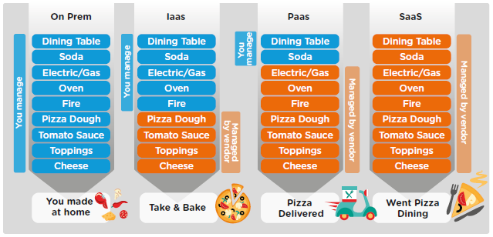
Pizza as a Service

Slide 6
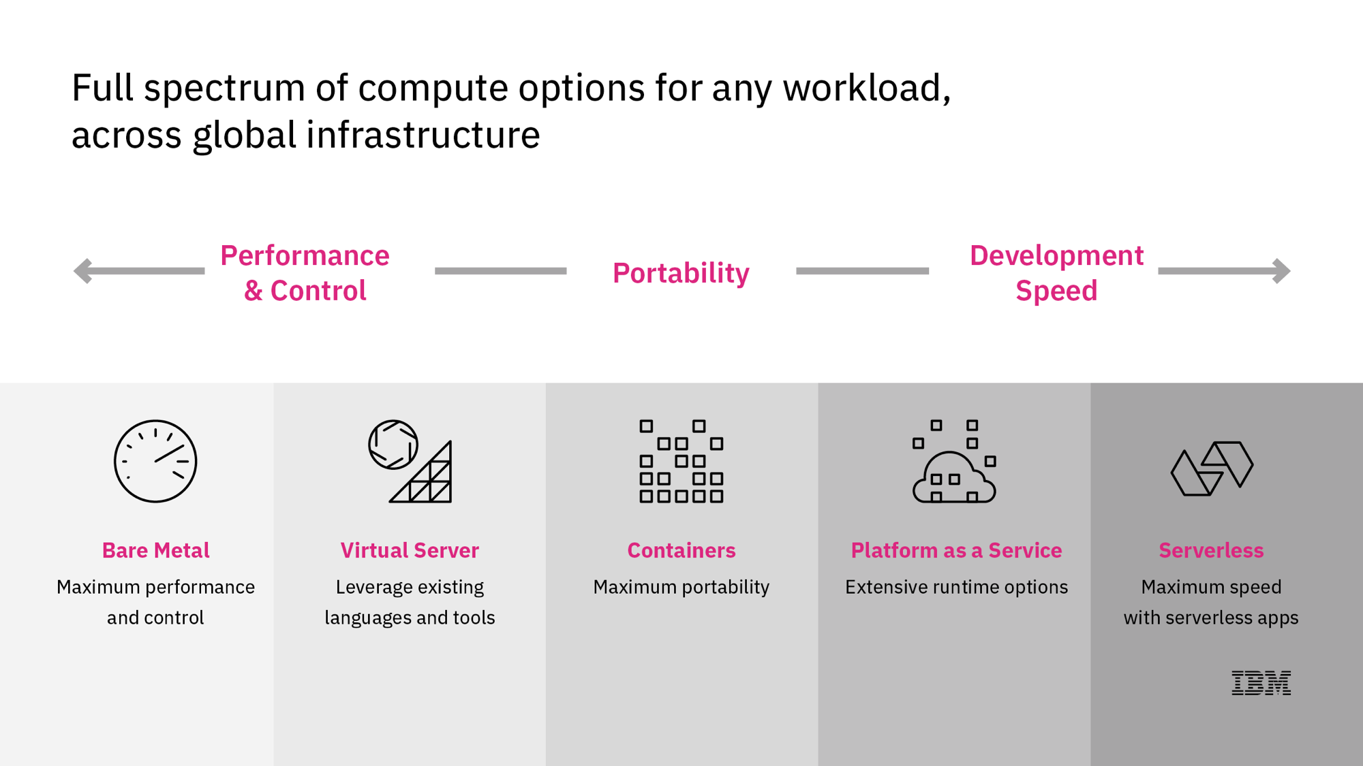

Slide 7
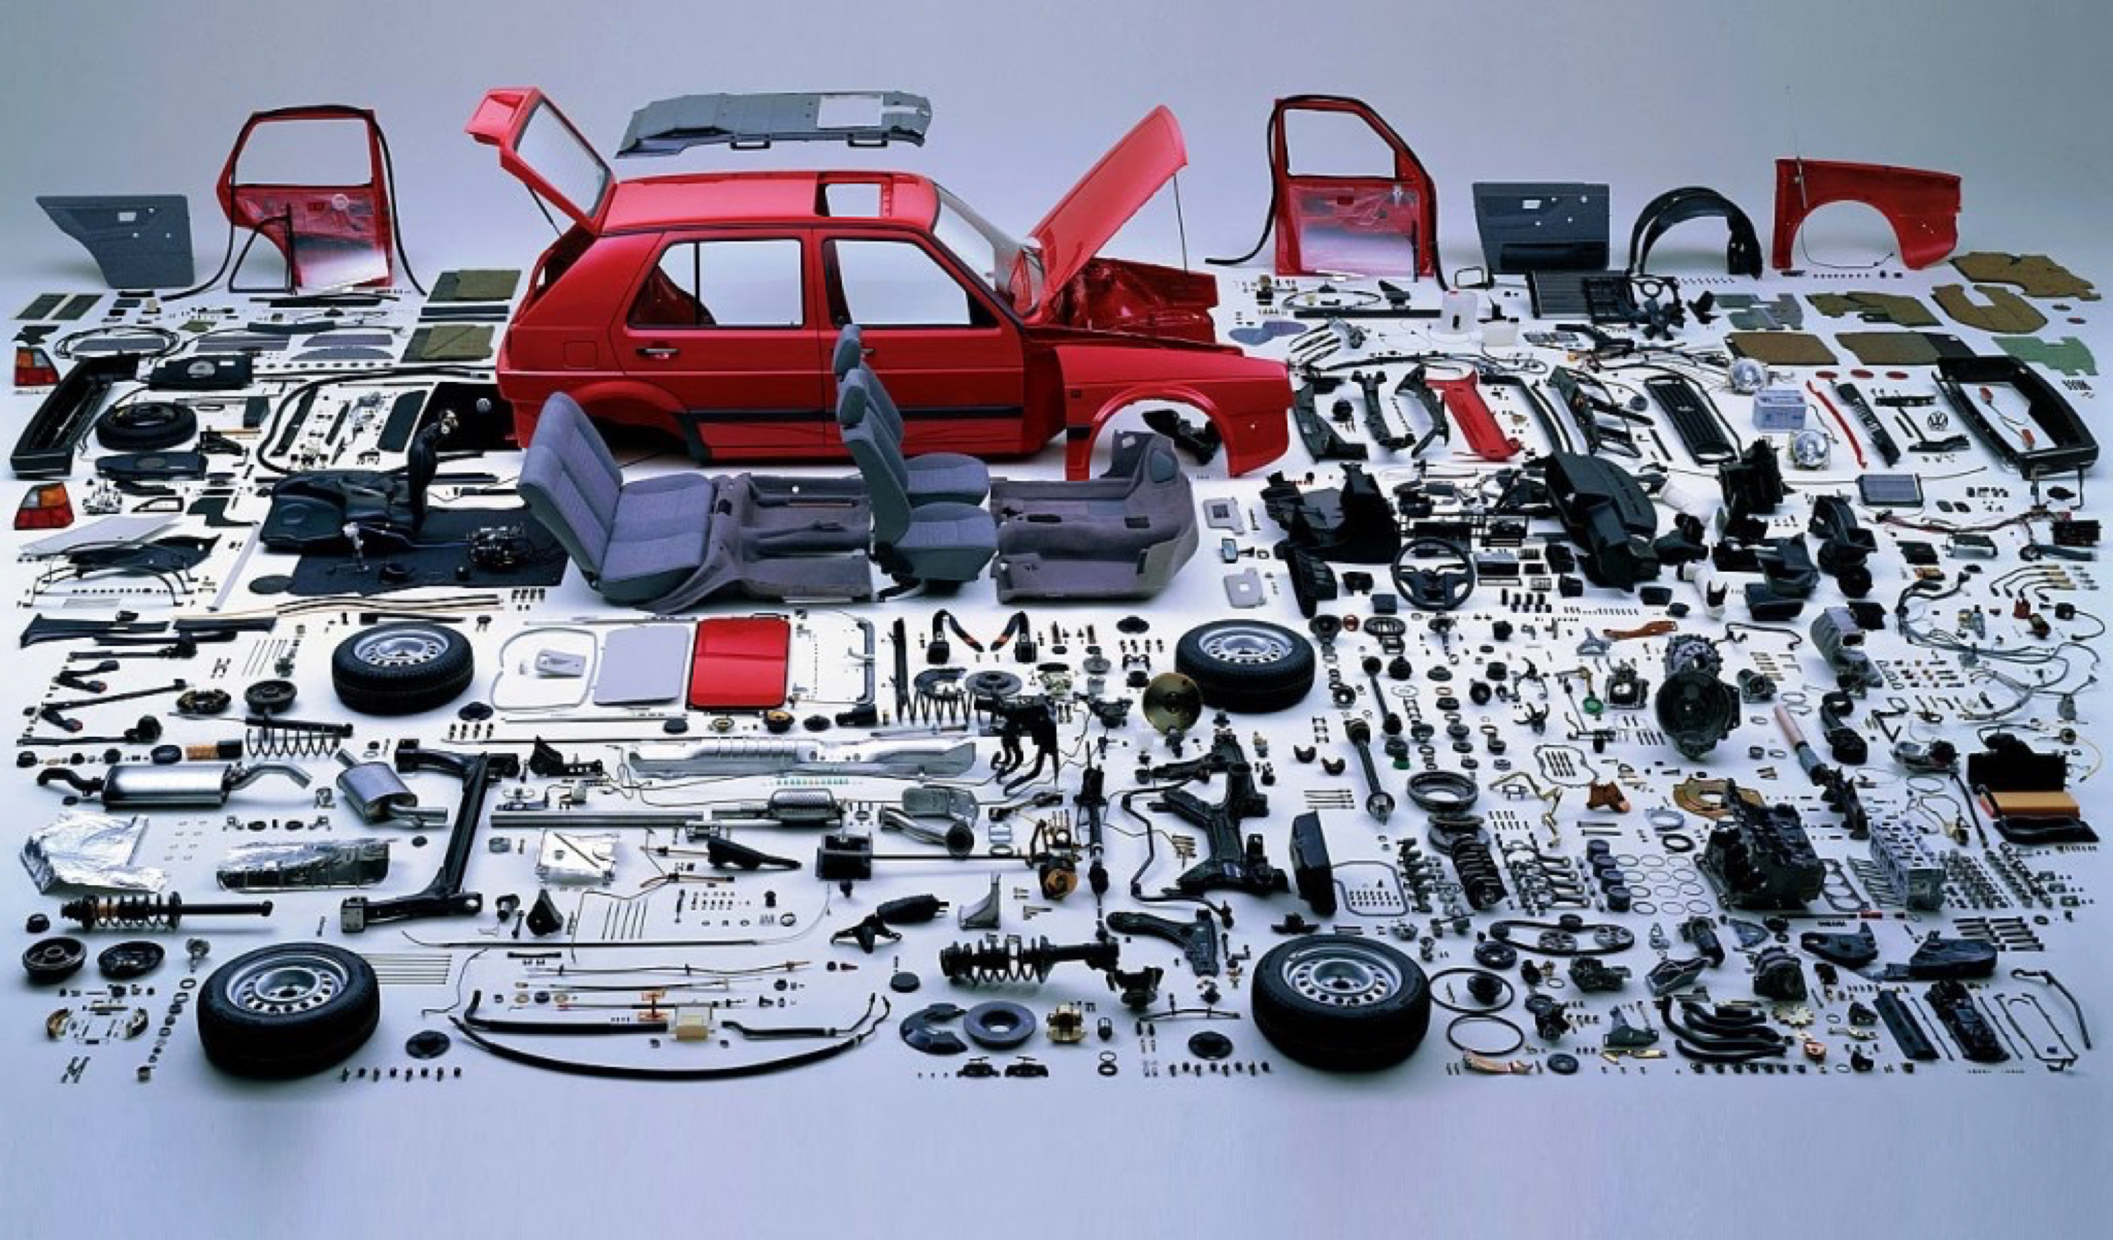
What is your preference – this?

Slide 8

Or this

Slide 10
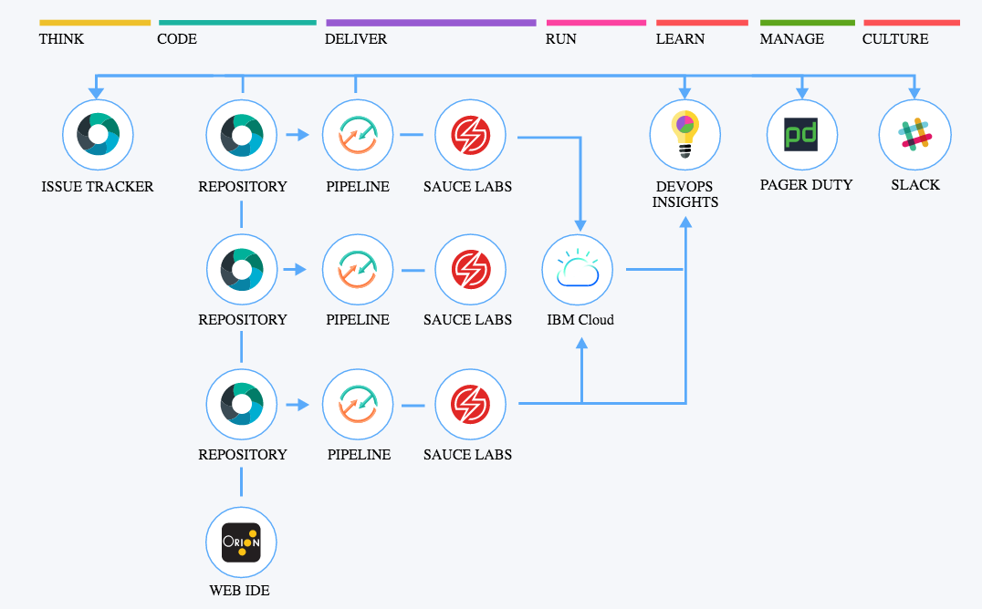
Continuous Innovation & Delivery
Fit for the enterprise: The DevOps experience is unified and open across IBM Cloud compute technologies, delivery methods, and integrated systems.

Slide 11
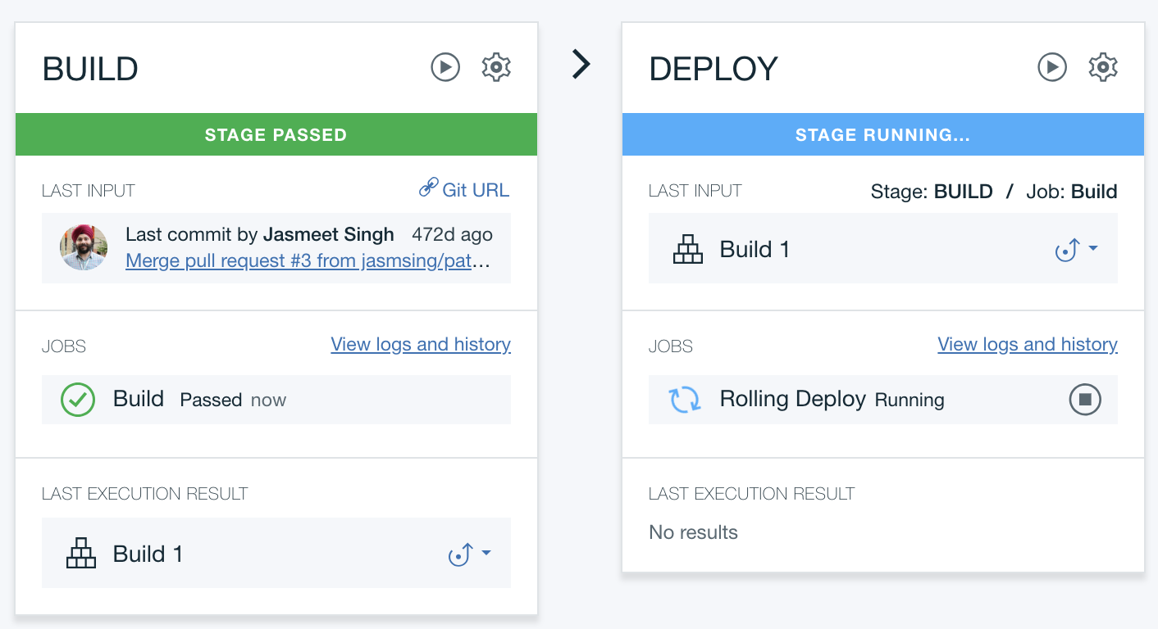

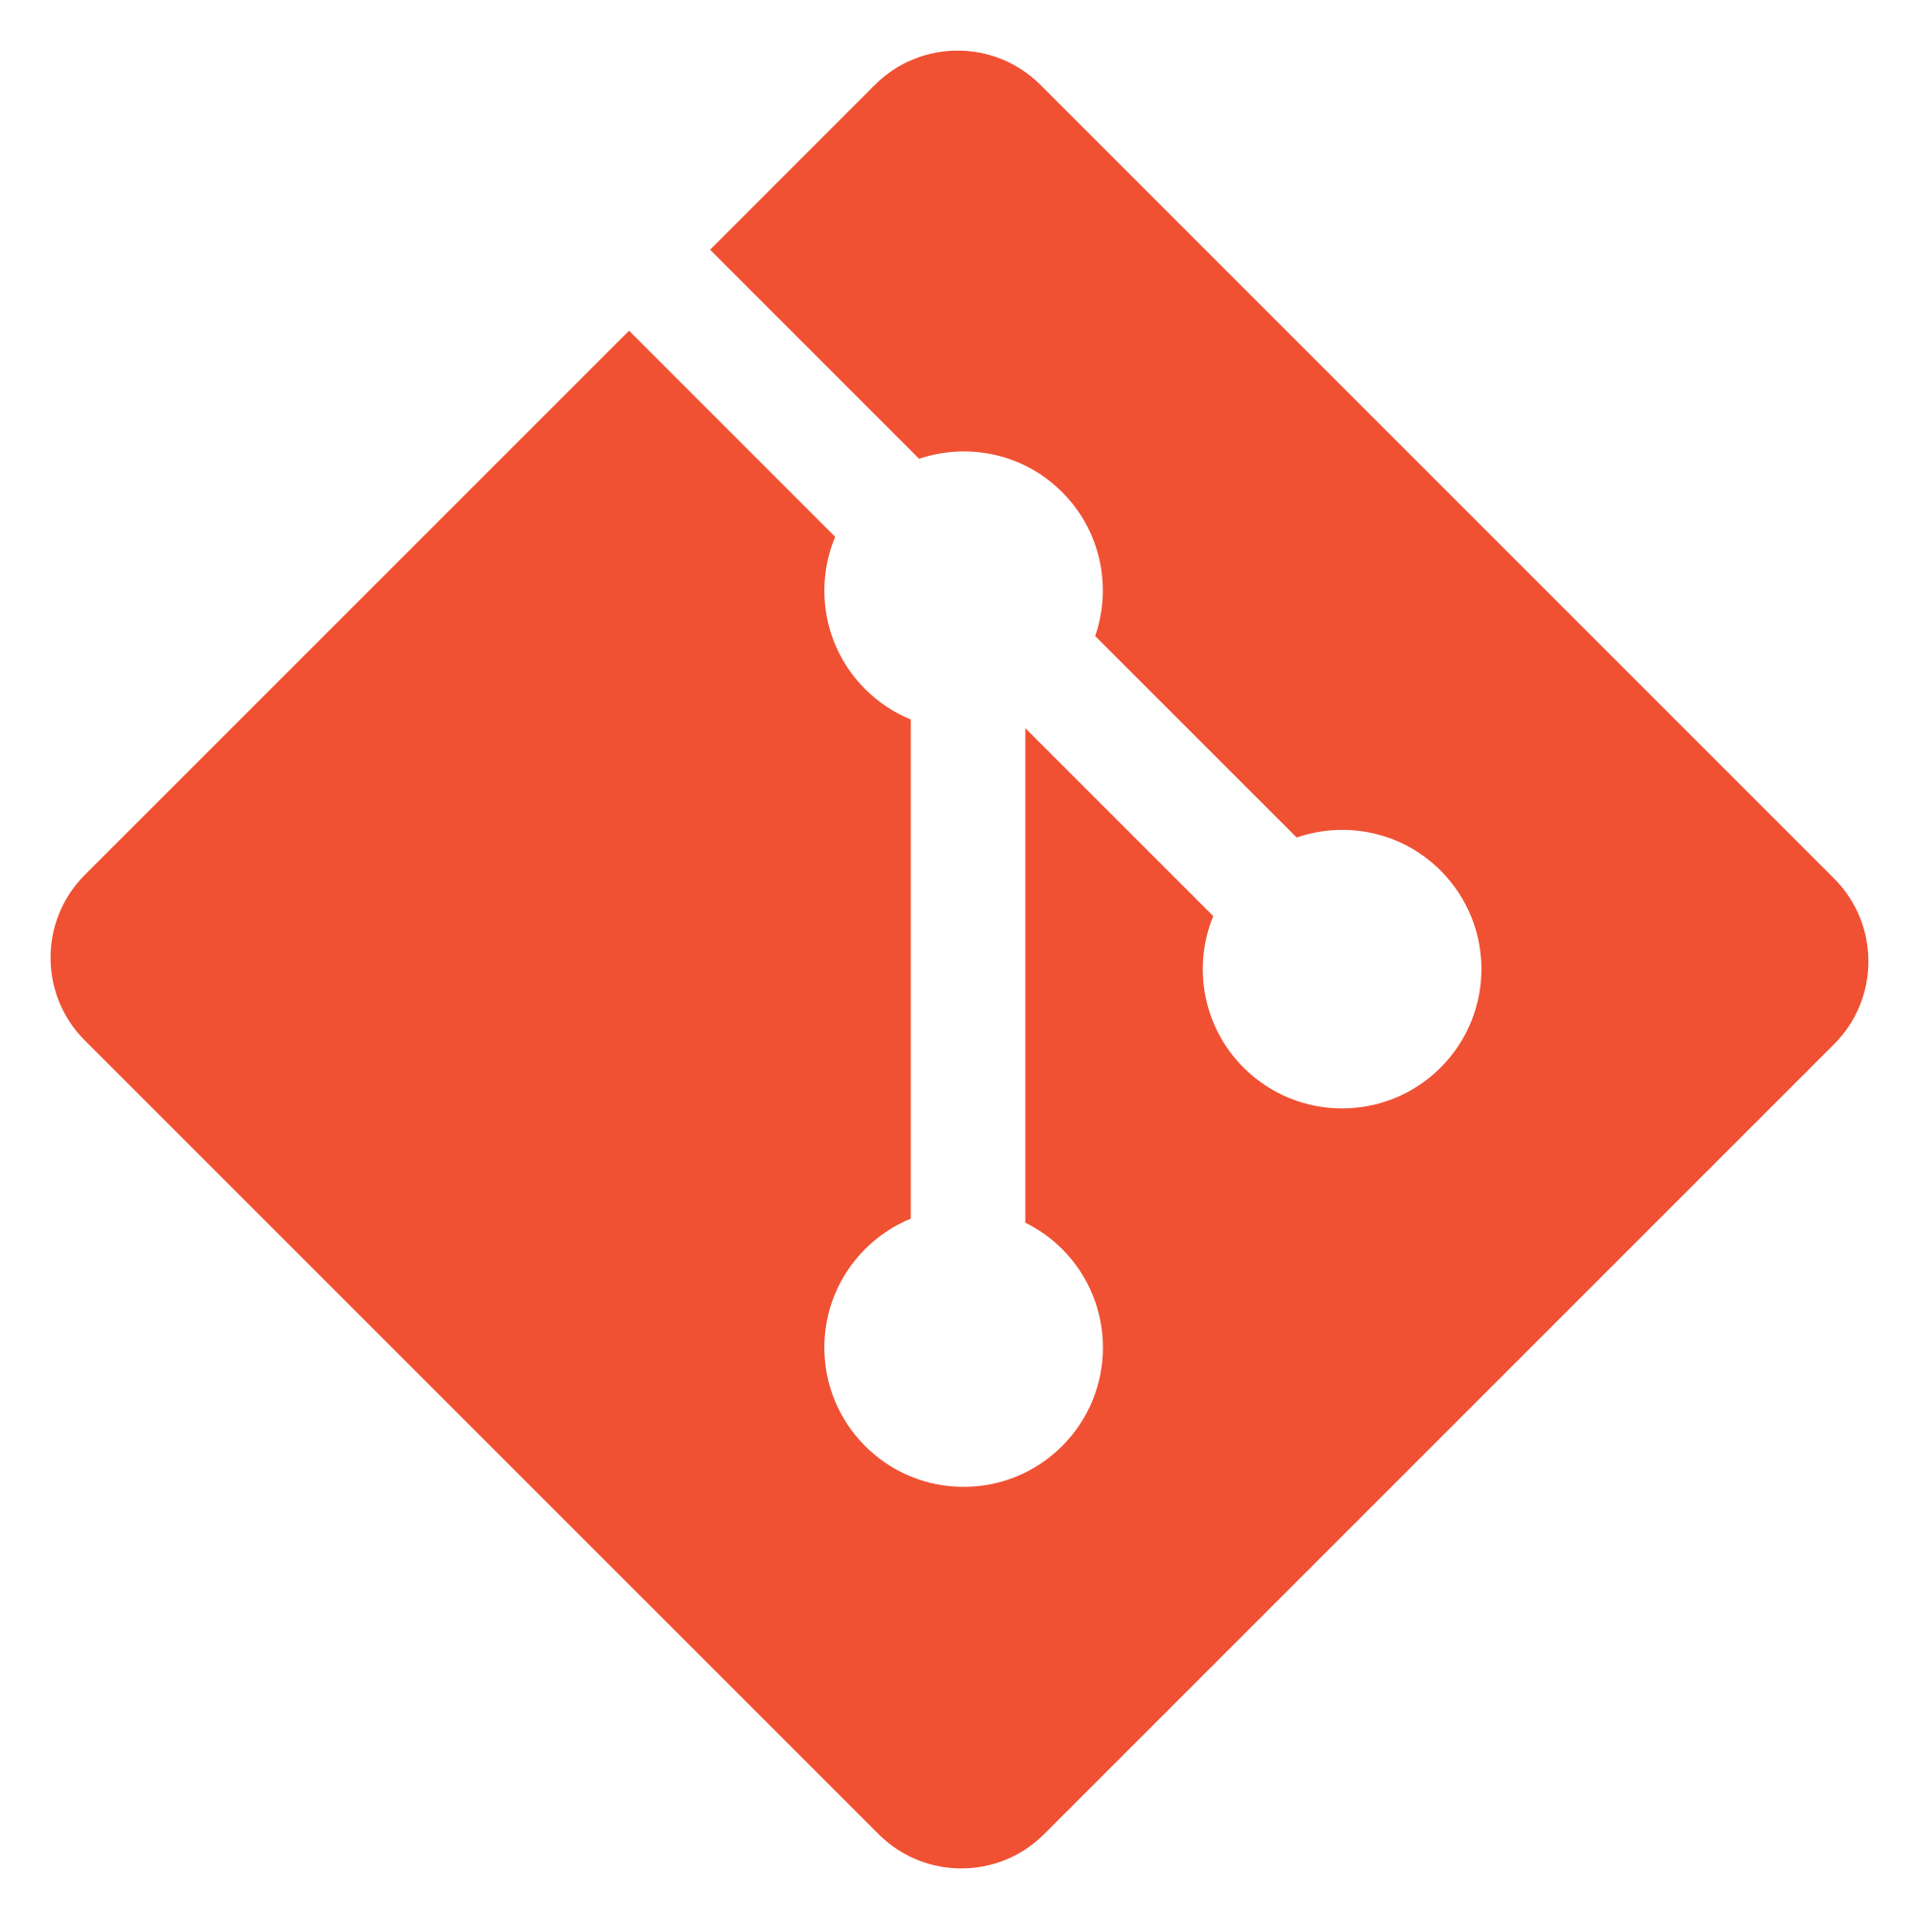

IBM Cloud DevOps Services
Everything you need to manage your code, builds and deployments in the cloud.
GIT
yourapp.mybluemix.net
git push

Slide 12
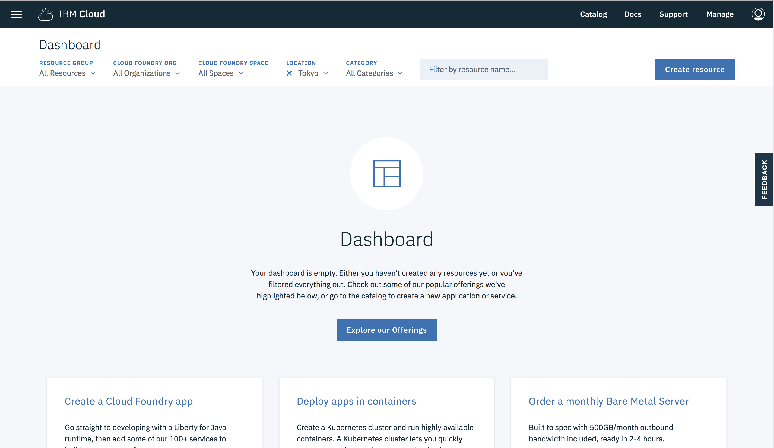
Let’s see it!
*click*
Notes:
Link to a page with 3 demo’s
1Minute Demo

Slide 13


Let’s Go!
13

Slide 14
Workshop
https://hrtclouddemo.github.io

Slide 15
1. Static Webpage

Slide 16
2. Collaborative Webpage

Slide 17
3. Consuming services

Slide 18
4. Porting chat app to IBM Cloud

Slide 19
5. Extend chat app with service

Slide 20





IBM Cloud
THANK YOU
QUESTIONS?

